Slide 1
Delightful DevOpsDays
Nathen Harvey
@nathenharvey

Slide 2
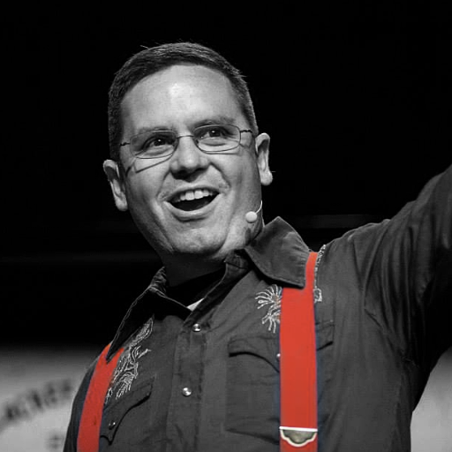

Nathen Harvey
VP, Community Development at Chef
Co-host of the Food Fight Show Podcast
Occasional farmer – http://ei.chef.io
Love eggs – http://eggs.chef.io
#hugops – http://hugops.chef.io
Part-time detective - http://bit.ly/detectivedecker
@nathenharvey
nharvey@chef.io

Slide 3
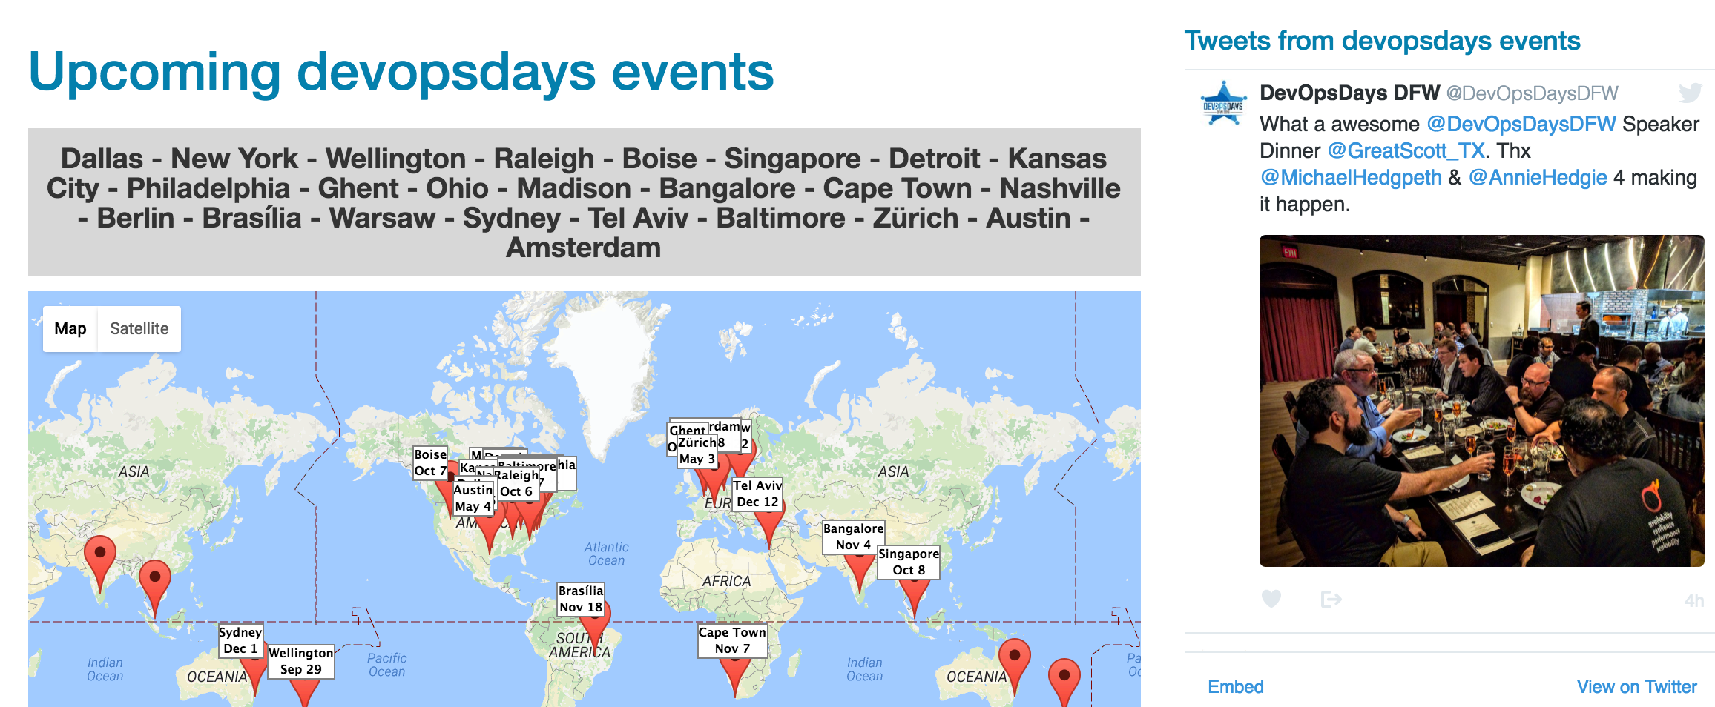
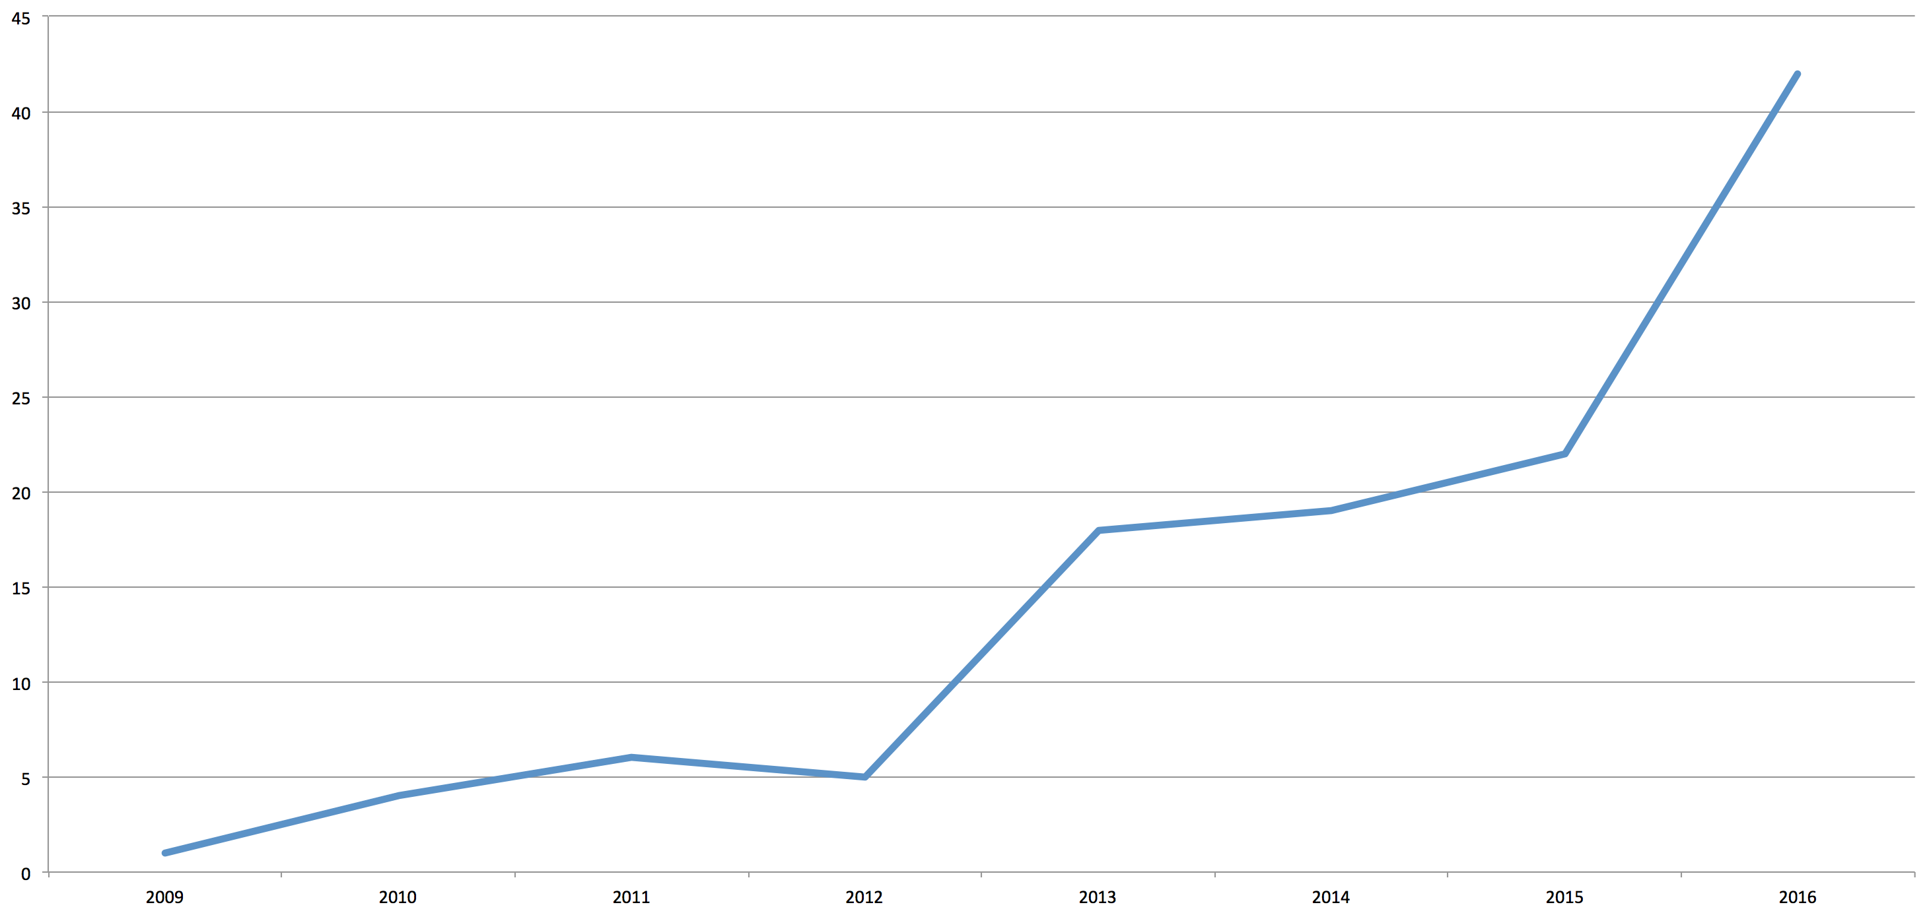
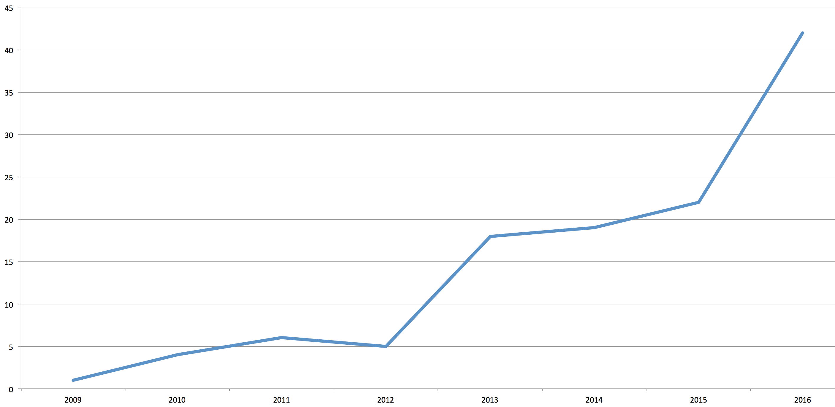
DevOpsDays
@nathenharvey
Notes:
First DevOps Days was in Gent, Belgium in 2009.
Today marks the start of the 95 DevOpsDays conference world-wide.
The chart shows the growth rate of DevOpsDays (inclusive of events through the end of the year)

Slide 4

DevOps
@nathenharvey
Notes:
http://www.auplod.com/u/luapod87348.png

Slide 5
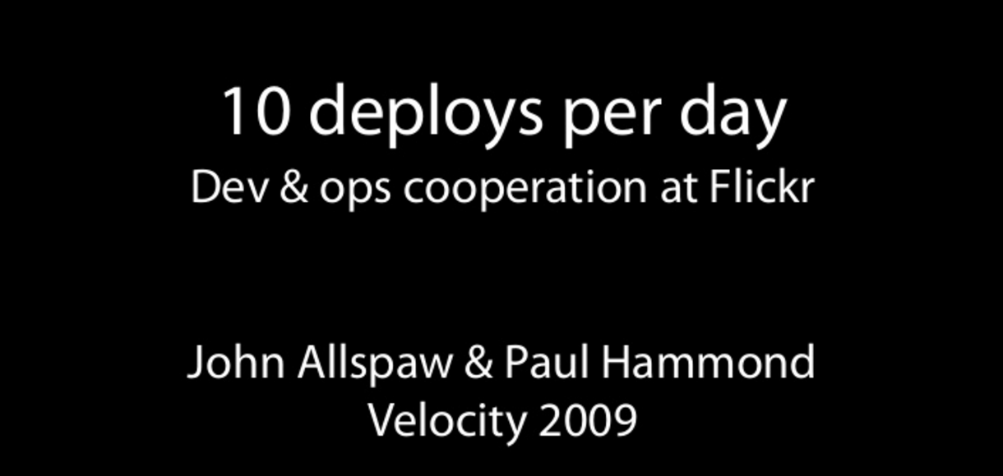

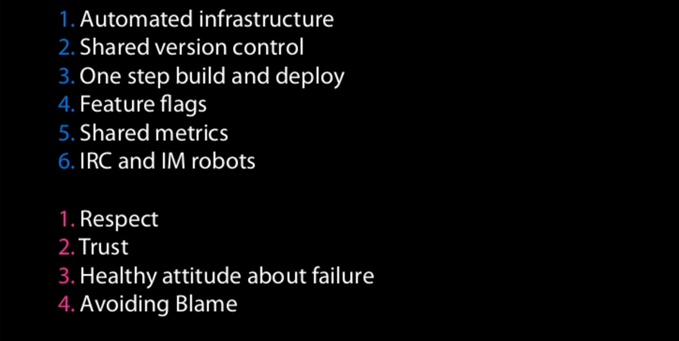
@nathenharvey
Notes:
https://www.youtube.com/watch?v=LdOe18KhtT4
http://www.slideshare.net/jallspaw/10-deploys-per-day-dev-and-ops-cooperation-at-flickr

Slide 6
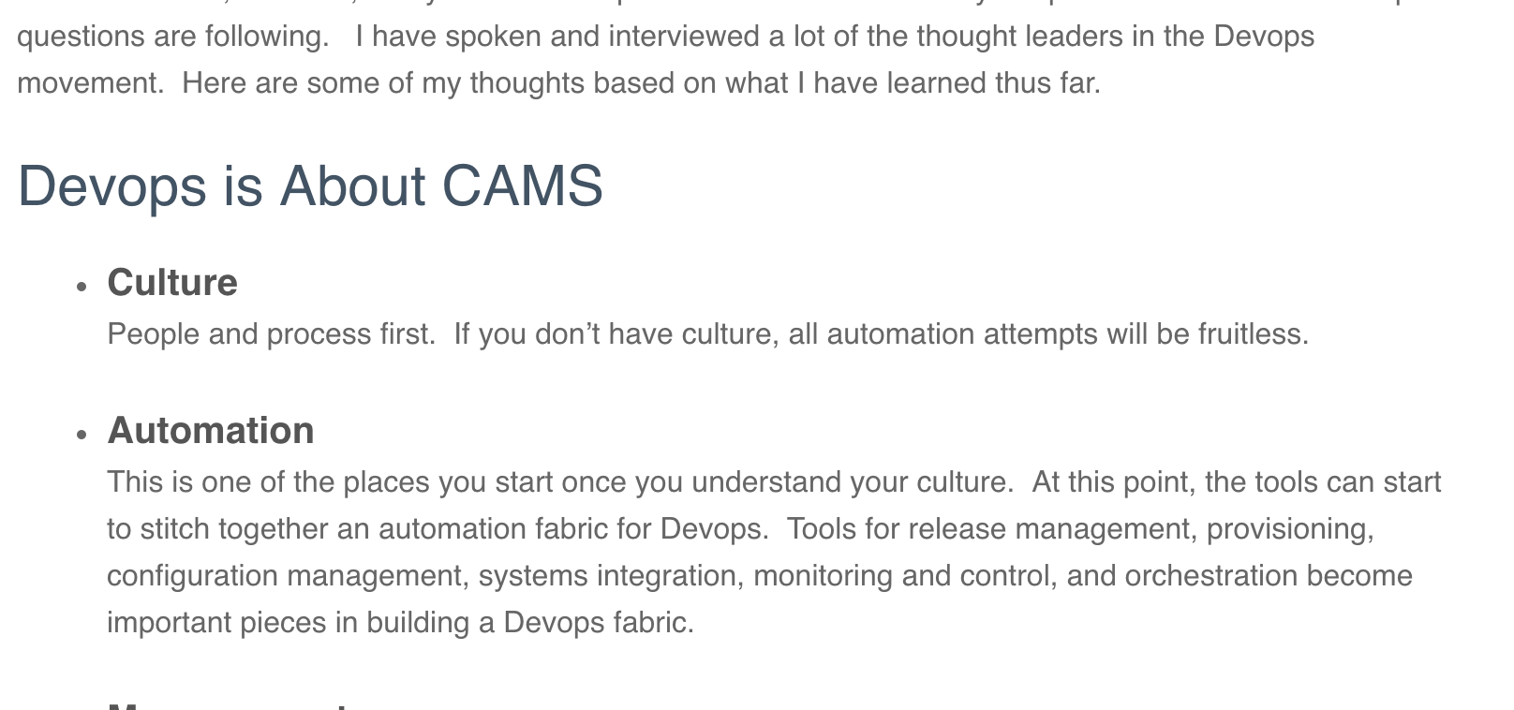
Culture, Automation, Measurement, & Sharing (CAMS)
@nathenharvey
https://blog.chef.io/2010/07/16/what-devops-means-to-me/

Slide 7
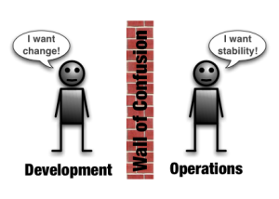
Wall of Confusion
@nathenharvey
http://dev2ops.org/2010/02/what-is-devops/

Slide 8
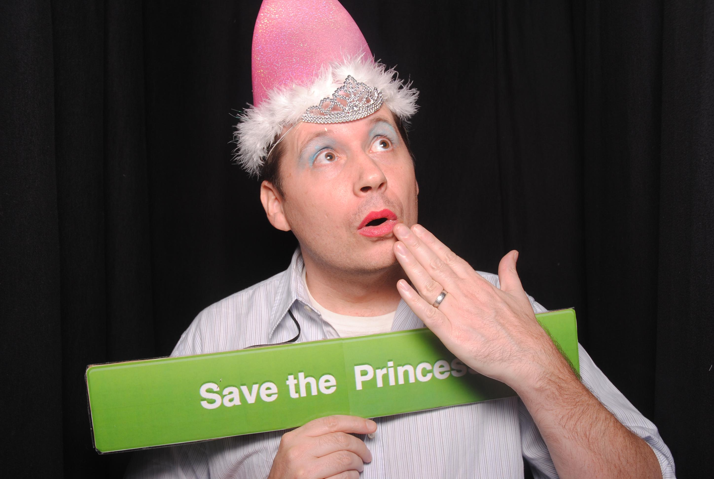
DEVOPS
A cultural and professional movement, focused on how we build and operate high velocity organizations, born from the experiences of its practitioners.

Slide 9
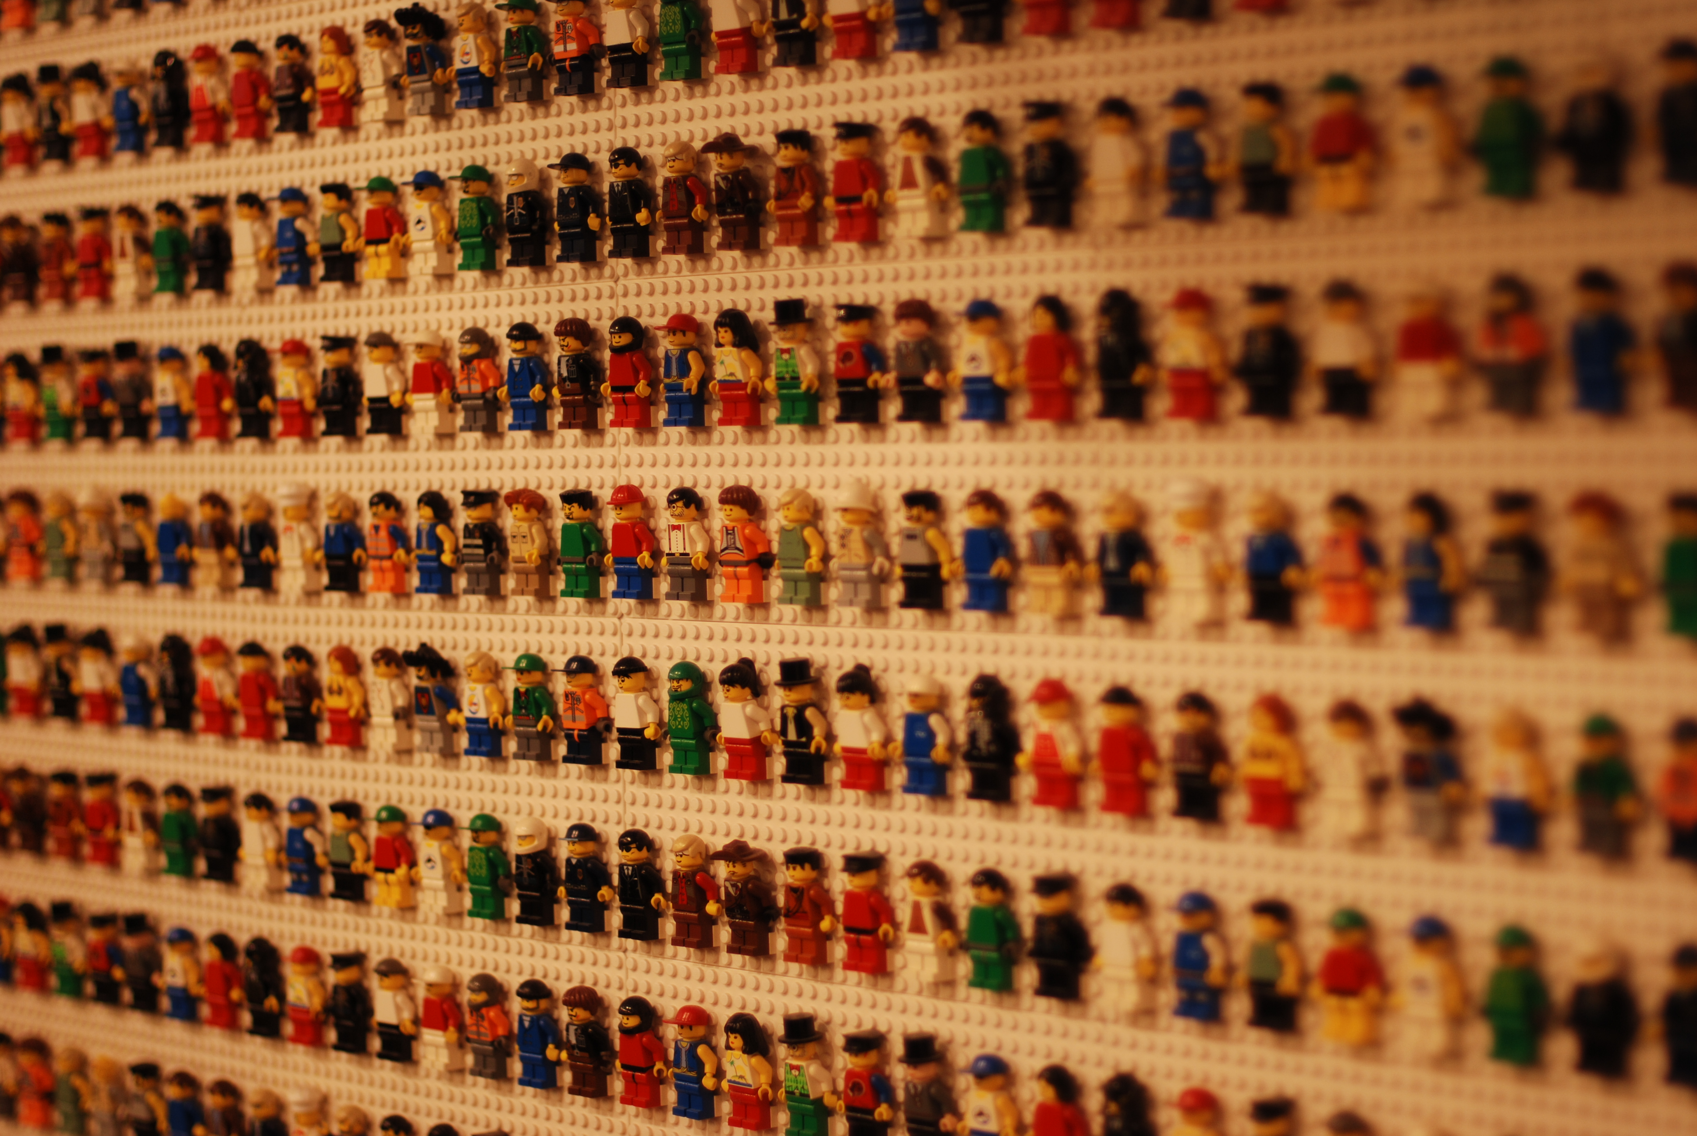
PEOPLE
PRODUCTS
COMPANIES
Notes:
Be our customers’ favorite company to work with.
Companies work with people, then products, then other companies.
You can easily find evidence of this everywhere you look within our customer base. When asked, ‘why did you select Chef?’ the community is the most often cited reason.
But we need all three. It’s not enough to have great relationships with awesome people who represent products that don’t drive success or companies that are difficult to work with.

Slide 10
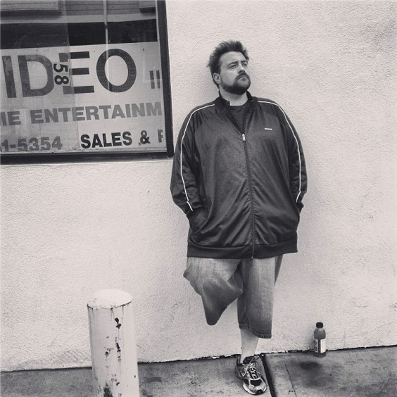
WE ARE LEAN
Eliminate non-value-added action (Waste/Muda)
Pull over Push
Kaizen (Continuous Improvement)
Kaikaku (Disruptive Change)
Small Batch + Experimentation

Slide 11


Slide 12
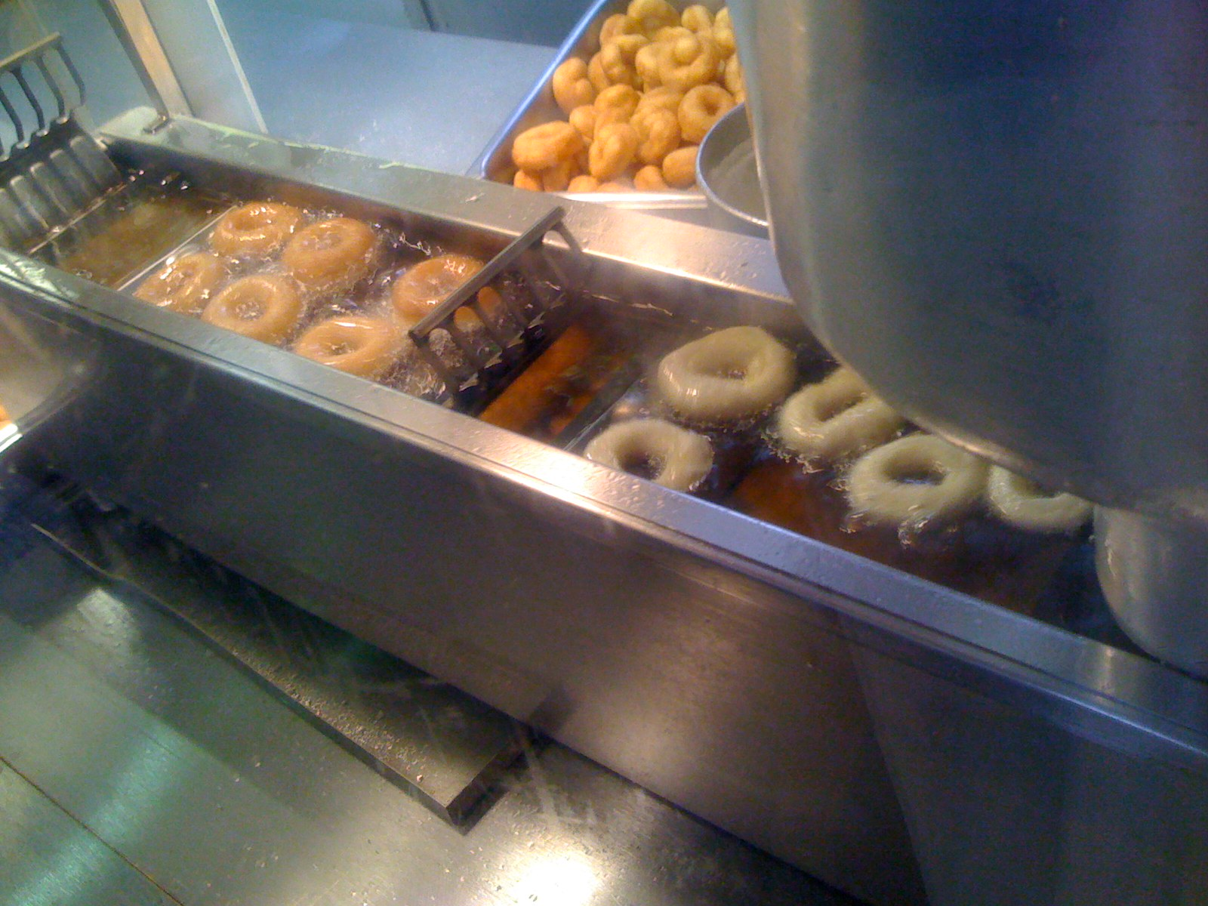
UBIQUITOUS
WORKFLOW
AUTOMATION

Slide 13
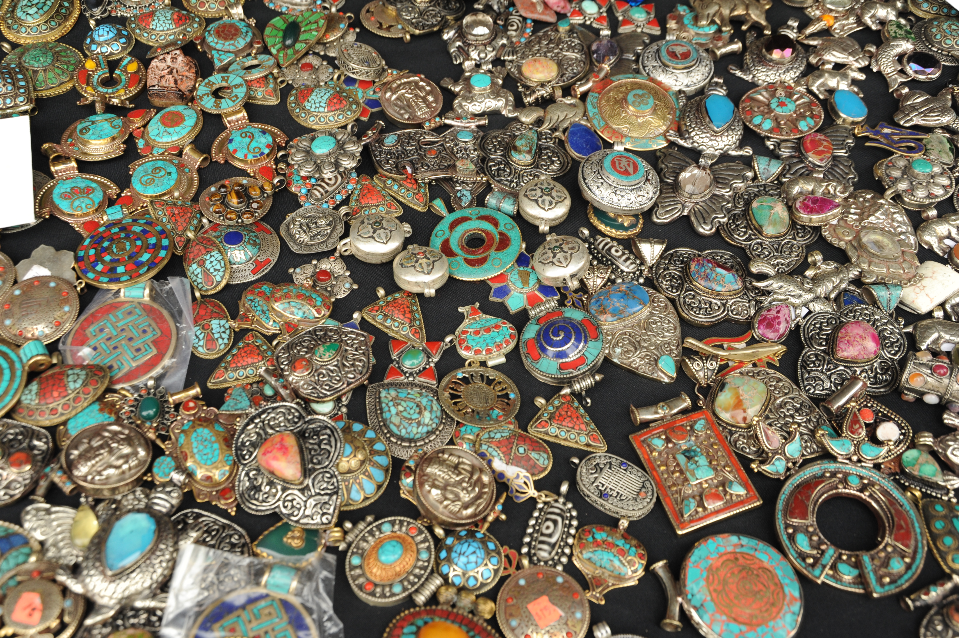
DIVERSITY

Slide 14
DevOpsDays
@nathenharvey
Notes:
First DevOps Days was in Gent, Belgium in 2009.
Today marks the start of the 95 DevOpsDays conference world-wide.
The chart shows the growth rate of DevOpsDays (inclusive of events through the end of the year)

Slide 15
DevOpsDays
Single Track
Ignite Talks
Sponsor Pitches
Open Spaces
@nathenharvey

Slide 16

DevOpsDays DFW
@nathenharvey
Notes:
First time in DFW
Special time for any DevOpsDays

Slide 17

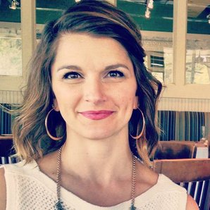

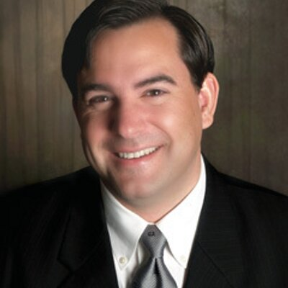
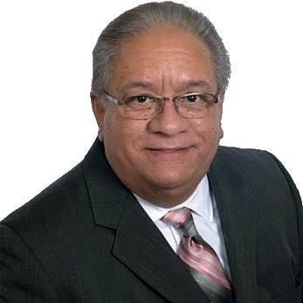



DevOpsDays DFW

Slide 18
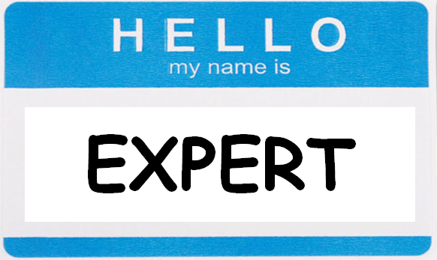
Notes:
Who are you?

Slide 19
DevOpsDays To Do
Prepare to be surprised
Meet 5 other people
Participate
@nathenharvey

Slide 20
You are responsible…
For your experience here at DevOpsDays
For your learning
For your development
For your career
For your teammates
For lots of important things
@nathenharvey

Slide 21
…but you are not alone!
Meet the awesome people around you
Find a mentor
Lean on your peers
Mentor someone
Give back
@nathenharvey

Slide 22
Get involved!
Be active in the community
Step out of the echo chamber
Step out of your comfort zone
Don’t fight stupid, make more awesome!
Jesse Robbins
@nathenharvey

Slide 23
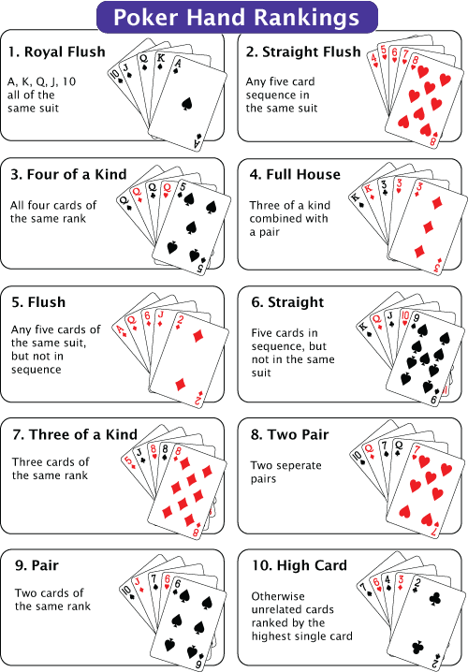
@nathenharvey
Notes:
http://1.bp.blogspot.com/-r3irH1HBos8/TiRS049qN-I/AAAAAAAAAHY/7xTeFohvPoI/s1600/Zynga+poker+hold+em+up+hands+crunchd+blog+best+poker+tutorial.gif

Slide 24
Nathen Harvey
VP, Community Development at Chef
Co-host of the Food Fight Show Podcast
Occasional farmer – http://ei.chef.io
Love eggs – http://eggs.chef.io
#hugops – http://hugops.chef.io
Part-time detective - http://bit.ly/detectivedecker
@nathenharvey
nharvey@chef.io

Slide 25
The 80s: The Decade that Made Us
…and will help define “DevOps”

Slide 26
Walk This Way

Slide 27
Walk This Way
https://www.morrisonhotelgallery.com/photo/default.aspx?photographID=7360

Slide 28
Walk This Way
“Oh, h*$l no! This is hillbilly gibberish”
https://www.morrisonhotelgallery.com/photo/default.aspx?photographID=7360

Slide 29
Walk This Way
“Oh, h*$l no! This is hillbilly gibberish”
“I don’t understand this code”
https://www.morrisonhotelgallery.com/photo/default.aspx?photographID=7360

Slide 30
Walk This Way
“Oh, h*$l no! This is hillbilly gibberish”
“I don’t understand this code”
https://www.morrisonhotelgallery.com/photo/default.aspx?photographID=7360
http://www.mikethefanboy.com/wp/wp-content/uploads/2012/04/Aerosmith-005.jpg

Slide 31
Walk This Way
“Oh, h*$l no! This is hillbilly gibberish”
“What the h*$l are they doing to our song?”
“I don’t understand this code”
https://www.morrisonhotelgallery.com/photo/default.aspx?photographID=7360
http://www.mikethefanboy.com/wp/wp-content/uploads/2012/04/Aerosmith-005.jpg

Slide 32
Walk This Way
“Oh, h*$l no! This is hillbilly gibberish”
“What the h*$l are they doing to our song?”
“I don’t understand this code”
“It works fine on my machine”
https://www.morrisonhotelgallery.com/photo/default.aspx?photographID=7360
http://www.mikethefanboy.com/wp/wp-content/uploads/2012/04/Aerosmith-005.jpg

Slide 33
What happened?
Producer Rick Rubin put Run DMC & Aerosmith in the studio together
“It was crazy good, man”

Slide 34
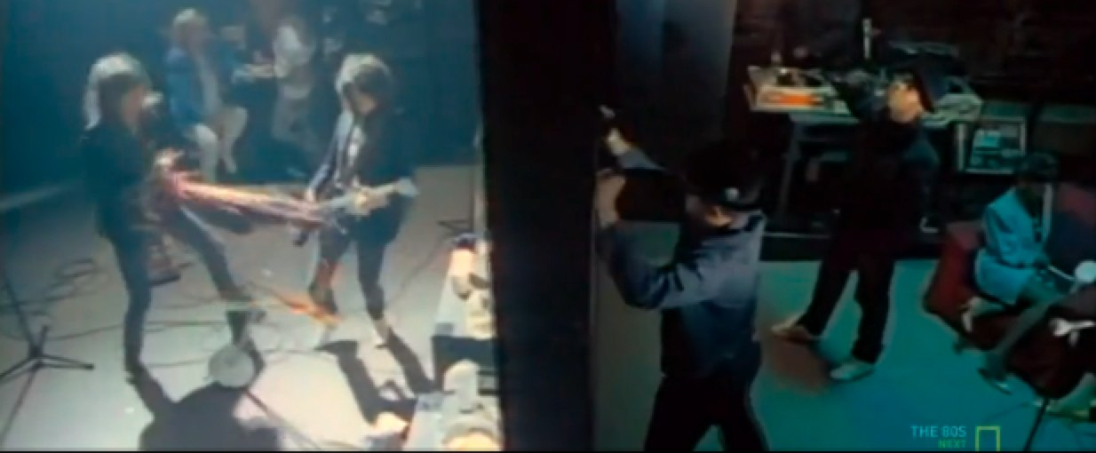
Walk This Way
The 80s: The Decade That Made Us
Notes:
In the classic video, the two bands start on either side of a wall. Much like Developers & Operations in a traditional environment.

Slide 35
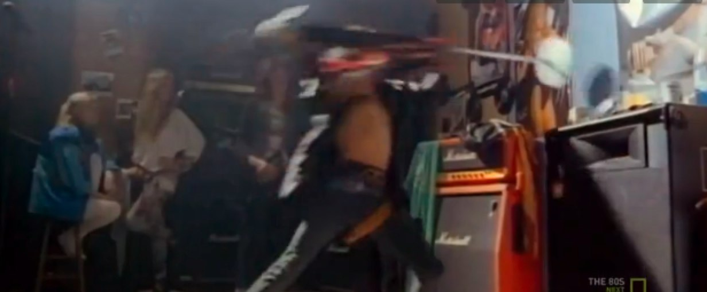
Walk This Way
The 80s: The Decade That Made Us
Notes:
They hear each other, realize that they’re playing the same song, and tear down the wall. The result: they come together and make some really incredible music.

Slide 36
Bring The Noise
http://userserve-ak.last.fm/serve/_/44943949/Anthrax+feat+Public+Enemy+AnthraxPublicEnemyrockrapmash9.jpg

